Slide 1
Matt’s Case Study – FOS
Product Features, Capabilities, and Experiments for Mobile Application

Slide 2



Competition
Grub Hub
Door Dash
Foodora
Case Study App

Slide 3
Current FOS Business Landscape
Delivery > Dine
More People are Staying In.
Cost-Conscious
Bang for their buck.
Health Aware
Healthy options.
Mobile Inclined
Ordering on the go.

Slide 4
Business Objectives
Mobile App Customer Purchase Funnel
Getting users to come to the app.
Acquisition
Getting users engaged in the app.
Activation
Getting users to return to the app.
Retention
Referral
Revenue

Slide 5
My Hypothesis / Assumptions
1
2
3
Categories
‘Hot’ Category
Point System
I believe if we have categories that are aligned with recent customer behaviors more users will place orders. *Healthy, *Cheap, *Low Cost – High Reviews *Weekly Deals
I believe if we house a Front Page tab with the ‘highest trafficked’ categories users wont fall into analysis paralysis.
I believe if every order placed awards points – more users would return to the app.

Slide 6
My Hypothesis / Assumptions
4
5
6
Coupon
Weekly Deals!
Personalized Feed
I believe if users are awarded substantial coupons it would leave to higher acquisition rates.
I believe with a weekly deal category more users would convert to placing an order.
I believe with a personalized front page feed more users would convert to placing an order.

Slide 7
Interview Questions
Tell me about the last time you ordered food online?
How do you feel about the solution, feature, price?
What was the most frustrating thing?
What do you wish you could do?
How would your experience be different if you had this?
How would you use this feature?
5 Why’s? - Eric Reis
If you had a magic wand and with one wave you could change something, what would it be?
Would you like addition categories added: *Healthy, *Cheap, *Low Cost – High Reviews?
Would you tap on ‘Hot’ categories such as *Healthy, *Cheap, *Low Cost – High Reviews?
Would a coupon incentive you to download a new FOS app?
Would a point system incentivize you to come back to this website over another FOS?
Would a page that populates a personalized feed based on your previous orders interest you? Open, and just scroll down?
--
Questions Added to Later Interviews:
How often do you visit your FOS app without knowing what you want?
Would having a user profile so you could see what your friends have ate and reviewed highly interest you?
Would you like an *estimated cost* when ordering, so you’re aware of the accumulated price?
Open-ended questions.
Looking for: Pain, Value, Motivation.
Challenge Assumptions.
Be Empathic.

Slide 8
Key Interview Insights
High % of the time people open the app without knowing where they’re eating.
1
Users want relevant categories.
2
Points successfully incentivize loyalty.
3
Users want to see what their friends are eating.
4
People need help deciding where they’re going to eat.
5

Slide 9

Carmen Labeouf
User Persona
Pain-Points
Too many options leading to analysis paralysis.
Accumulation of many fee’s.
Long ordering process.
Leaving the app without placing an order.
Young Professional – 29 years old.
Busy, Healthy, Indecisive
“Under 1% of the time I open the app - I know what I’m going to eat”
Needs
Summary
Getting a discount.
Healthy options.
Suggestions to help her pick where she’s eating.
Seeing where friends have been eating.
Being able to send friends restaurant suggestions.
Loyal to a FOS if there’s a reason to be.
Carmen is young professional that’s always on the go. She doesn’t always have time to make dinner every night and is hungry but her main problem is – she needs help figure out what she wants to eat.
She likes to eat healthy and would love to try the restaurants her friends eat at. Gaining points to get a deal on an upcoming will keep her coming back. She’s not cheap but she loves getting bang for her buck.

Slide 10
User Problems
She is busy - As a user I want to be able to choose what I want and order quickly.
She want to be healthy – I want the convenience of eating out but I want to stay healthy.
She cannot decide – I navigate the website forever and leave without placing an order.
She cost-conscious– The service fees and the delivery fees on top of the food make my orders very expensive .

Slide 11
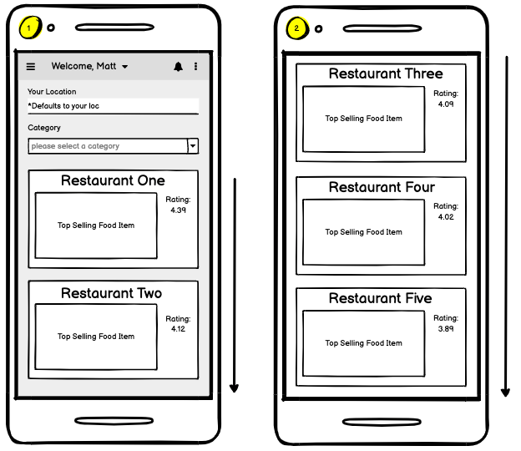
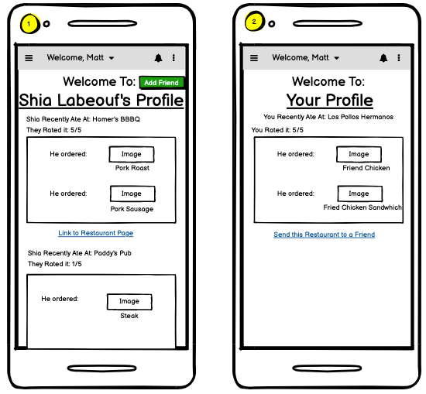
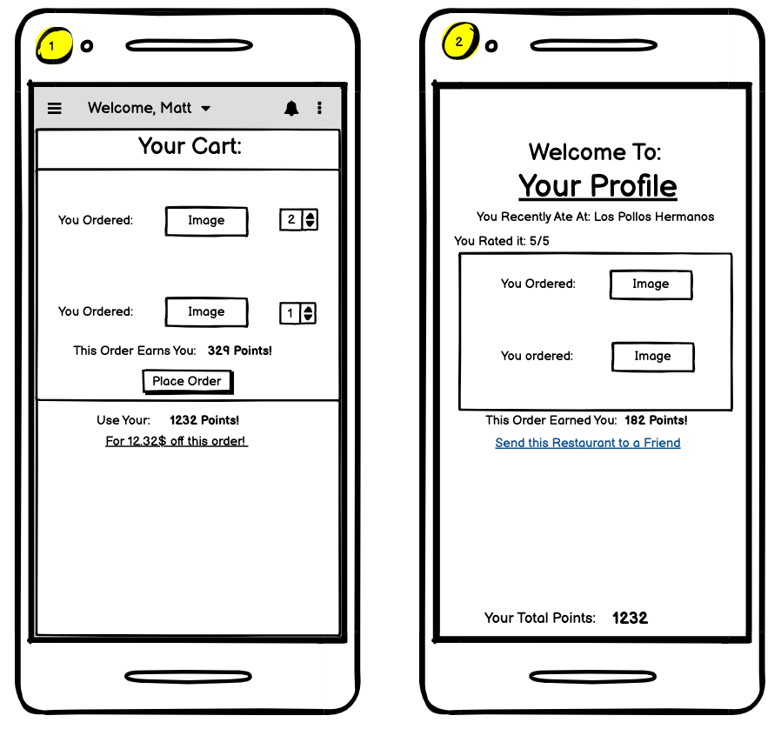
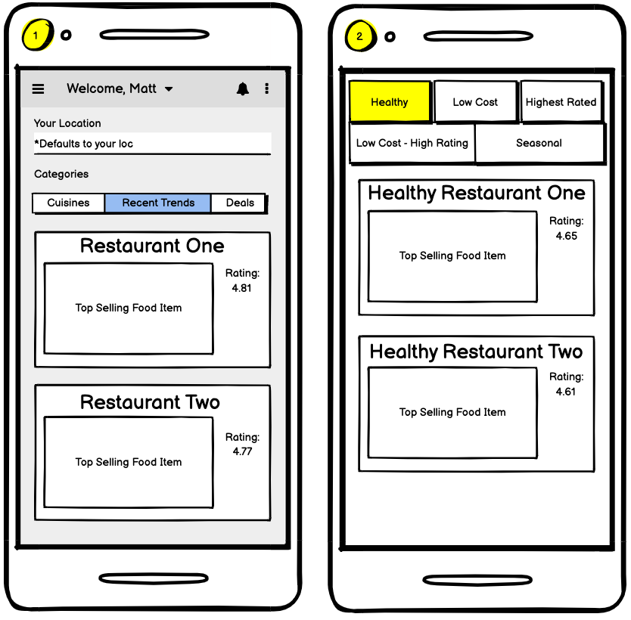
Point System
Proposed Features
Personalized Feed
User Profiles
Recent Trends

Slide 12
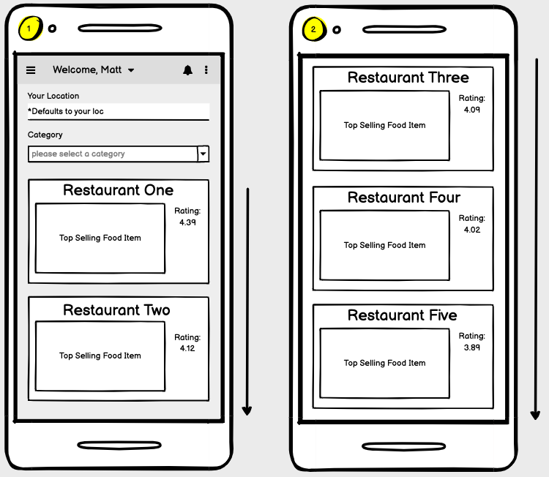
Feature One
Personalized Feed

Slide 13
Feature One - Personalized Feed
Problem
Hypothesis
Based on my research users find it difficult to make a restaurant choice and thus leave the application without placing an order - leading to lower conversion rates.
I believe that by building a personalized feed based on previous activity, more users will place an order - leading to higher conversion rates.

Slide 14
Feature One – Personalized Feed

Slide 15
How Would I Measure Success?
Increase Activation
Number of users logging in and successfully converting to a transaction (conversation rate increase).
Average time to order.

Slide 16
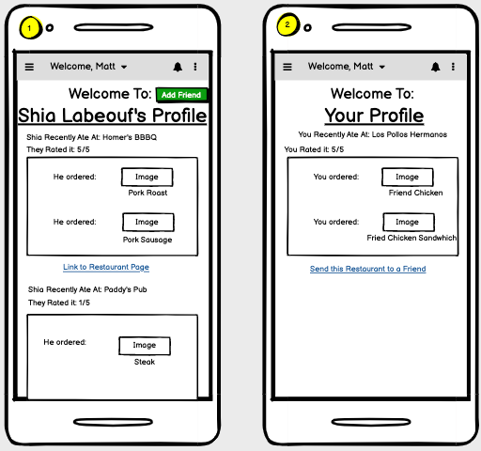
Feature Two
User Profiles

Slide 17
Feature Two – User Profiles
Problem
Hypothesis
Based on my research users find it difficult to make a restaurant choice and thus leave the application without placing an order - leading to lower conversion rates.
We believe that by building personalized profiles indecisive users, can see what their friends are eating and place more orders based on their friends order history.

Slide 18
Feature Two – User Profiles

Slide 19
How Would I Measure Success?
Increase Retention
Increase Referral
Number of users who continue engaging with the app over time (Increase in MAU by x%).
Number of Push Notifications - App starts
Number of users sending recommendations to out of app users.
Number of opened recommendations.

Slide 20
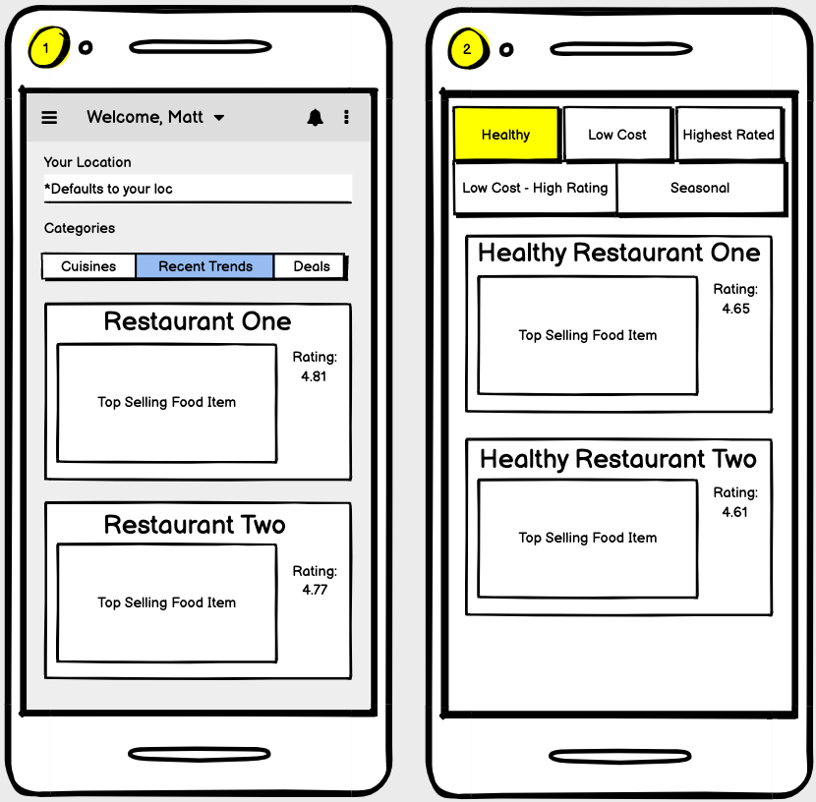
Feature Three
Categories

Slide 21
Feature Three – Categories
Problem
Hypothesis
Based on my research users find it difficult to make a restaurant choice and thus leave the application without placing an order - leading to lower conversion rates.
I believe that by creating categories based on recent user trends users will place more orders– leading to enhanced activation and retention.

Slide 22
Feature Three – Categories

Slide 23
How Would I Measure Success?
Increase Activation
Total number of clicks on ‘Recent Trends’
Number of users logging in and successfully converting to a transaction (conversation rate increase (or lower bounce rate)).
Number of Push Notifications - App starts

Slide 24
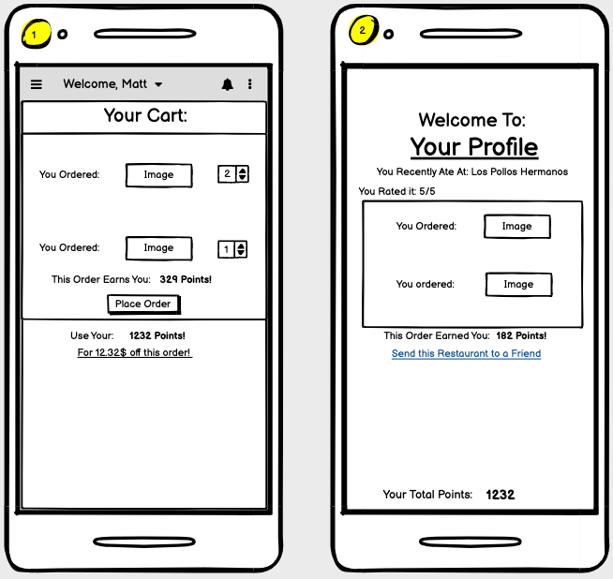
Feature Four
Points

Slide 25
Feature Four – Point Incentives
Problem
Hypothesis
Based on my research users feel they’re spending too much money and feel they’re not getting discounts - leading to lower activation and retention.
We believe that by building a point system users will feel they’re getting a discount and return to our app – leading to enhanced activation and retention.

Slide 26
Feature Four – Point Incentives

Slide 27
How Would I Measure Success?
Increase Retention
Increase Activation
Increase Referral
Increase Revenue
Number of users who continue engaging with the app over time (Increase in MAU by x%).
Churn - % of users who uninstall the app over a period of time.
Number of Push Notifications - App starts
The number of points a user is spending.
Number of users sending recommendations to out of app users (these users get a coupon, number of these coupons redeemed).
LTV – Compare average spending with previous mobile environment.

Slide 28
Prioritization – Personalized Feed
5
Massive Impact – Every user would utilize this feature and frequently. Helps solve significant issue.
Impact
5
High Effort – Need to incorporate data science. Build recommendation engine.
Effort
5/6
All but one user advocated for this feature.
Users
Deliver MVP and iterate.

Slide 29
Prioritization - User Profiles
3
Medium Impact – According to my research this feature would have strong reach and medium utilization.
Impact
3
Medium Effort – Profile creation, design, houses many components but not complex
Effort
4/6
All but two users advocated for this feature. *Few didn’t want everyone to see their orders.
Users
Fake Door.

Slide 30
Prioritization - Categories
4.5
Massive Impact – High reach and high utilization.
Impact
2
Low Effort – Restaurants have existing categorizations and rating.
Effort
6/6
All Users advocated for this feature.
Users
Deliver MVP and iterate.

Slide 31
Prioritization - Points
5
Massive Impact – Far reach and high utilization.
Impact
4.5
High Effort – Complex calculations. Change billing calculations. Touch many things.
Effort
6/6
All Users advocated for this feature.
Users
Deliver MVP and iterate.

Slide 32
All Features - Prioritization
Points
Personal
Feed
Categories
High Impact
User Profile
Low Impact
Low Effort
High Effort

Slide 33
Thank You
Questions?
Feedback? (How can I be better?)

Slide 34
Appendix

Slide 35

“I have many assumptions about the user - but talk to them and validate”
People open the app and generally know where they want to eat.
People open the app to figure out where they want to eat.
People know which cuisine they want.
People know nothing specific about what they’re eating.
More categories the better.
Categories aligned with customer behaviors are great, but you don’t want analysis paralysis.
Points is a possible solution for retention.
People would stop using all other FOS apps if one offered points.
User profiles to see where people are eating would be intrusive.
Users would love to see where people they know are eating.
People prefer delivery for the convenience.
Added costs bother people. If possible, they would avoid the delivery fee.

