Slide 1
Management Dashboard
Track Your Users

Slide 2
Rep Level Users
Input Data
Fast and Easy Data Input
Updating Data
Expedite Data Submission
100% Mobile
Input Data Anytime, Anywhere
Account Workbench
All Historical Client Information

Slide 3
Rep and Manager In Concert
Rep Level
Manager Level
Data Submission
Individual Activity Drilldown
Updating Data Submissions
Daily, Weekly, Monthly, YTD User Activity Reports
Account Workbench
User Comparison
100% Mobile
Client Activity Tracking

Slide 4
The Interview
They’re Busy..
Managing sellers, managing information, customer information, administration work, coaching their team.
…They Need User Comparison Data
Which members of their team are performing?
…They Need Account Comparison Data
Which accounts are being neglected?
…Tracking users Is hard
They’re leaving the web app without the data that would most benefit them.

Slide 5
Validating Assumptions
1
2
3
Training
Time-Wasting
Tracking Users
Directed to where these features are. Or implementing a training software.
Navigating throughout the site. Stringing together facts and it’s taking too long.
They’re not getting the data they’re looking for.

Slide 6
Problem and Competitors
Dashboard | Sales Force | Less Annoying CRM | Matt’s CRM
Quick Setup
Easy to Learn
Feature Rich
Tables, Graphs, Charts
Built for Managers
* At Additional Cost
* At Additional Cost

Slide 7
Problem and Business Impact
02
04
Every year a manager level users needs to allocate funds.
User tracking makes ROI clear.
Subscription
Allocate Funds
Pocket Book
Easy User Tracking
Retention
01
03
05
Revenue is subscription based.
Managers/Executives hold the pocket book.
Improve retention.

Slide 8

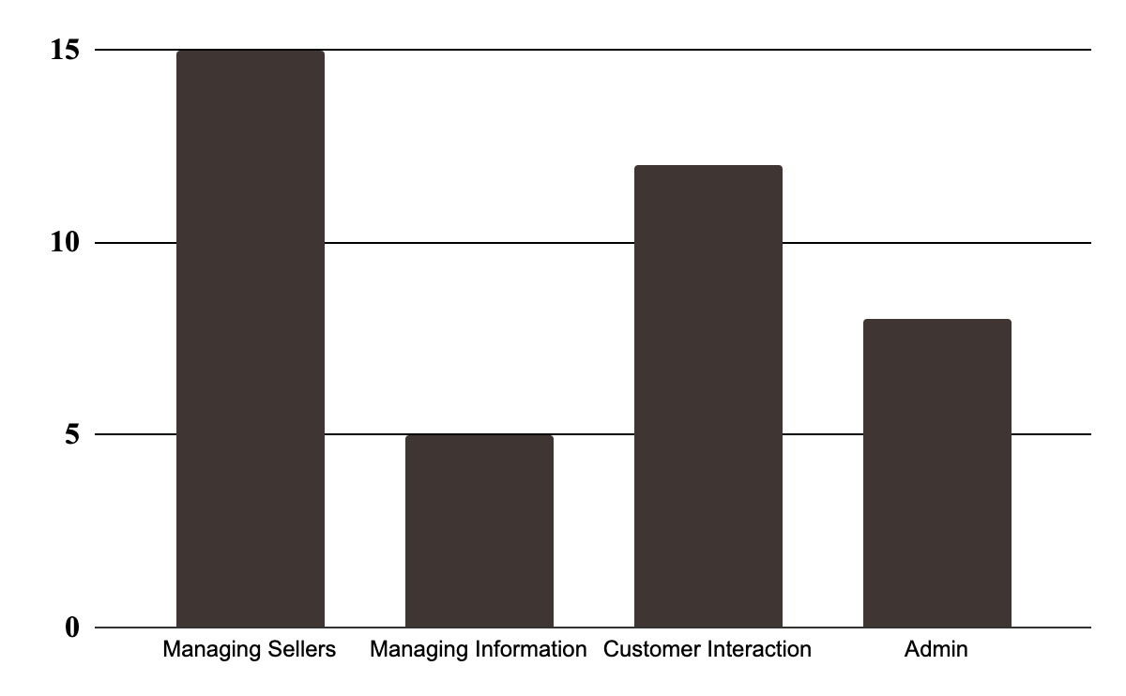
Carmen Labeouf
User Persona
Weekly Time Spent
Sales Manager
“I cannot find the information I’m looking for. I do not want to leave the website without finding the exact data I need.”
Summary
Carmen is a hands on sales manager. She’s enjoys providing guidance, settings sales quotas and goals, creating sales plans, and building the team.
This means that Carmen is in and out of meetings all day. When she has meetings she wants to know which salespeople are performing and hitting their numbers. As well as which accounts have been contacted and which have not.
Needs
Quickly be able to assess team performance
Varity of Data Insights
Pain-Points
Leaving without the data most pertinent to her team

Slide 9
Problem and Hypothesis
Problem
Hypothesis
Managers are struggling to track their users activity.
Building a managerial dashboard that houses key user tracking functionality.

Slide 10
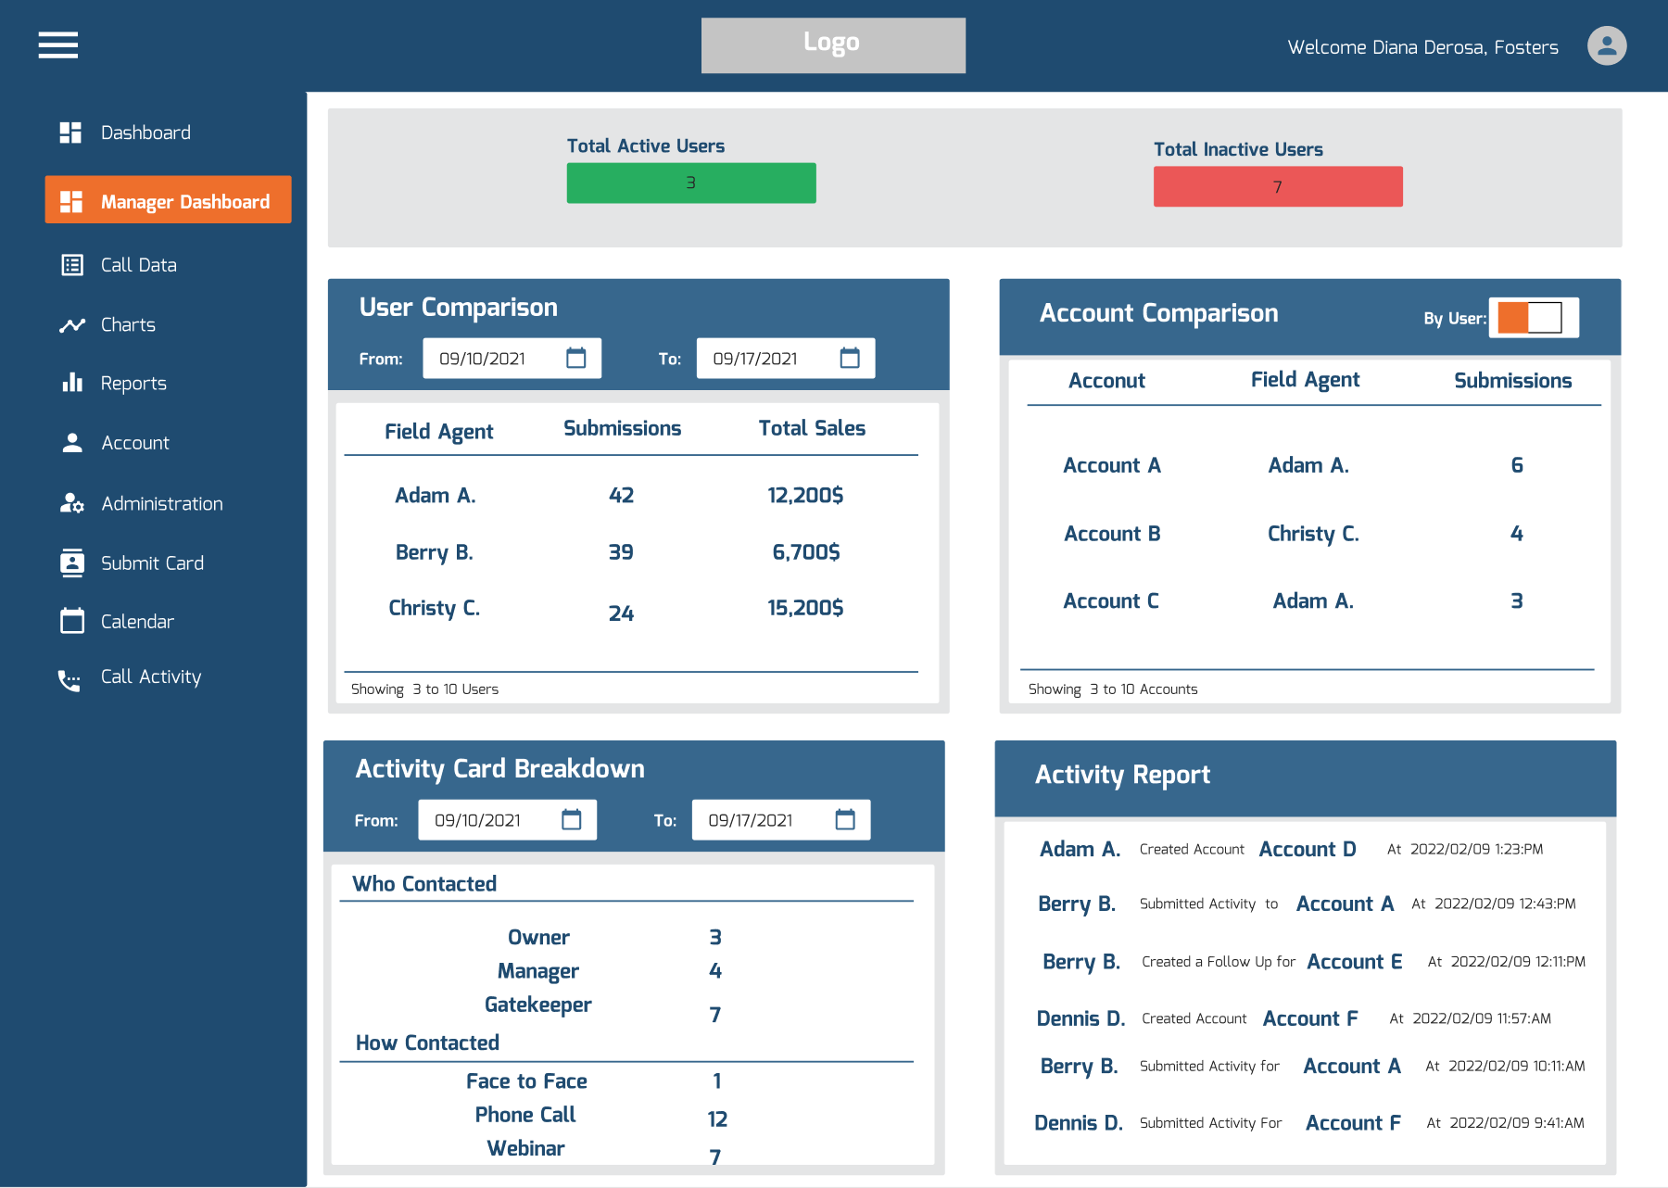

Slide 11
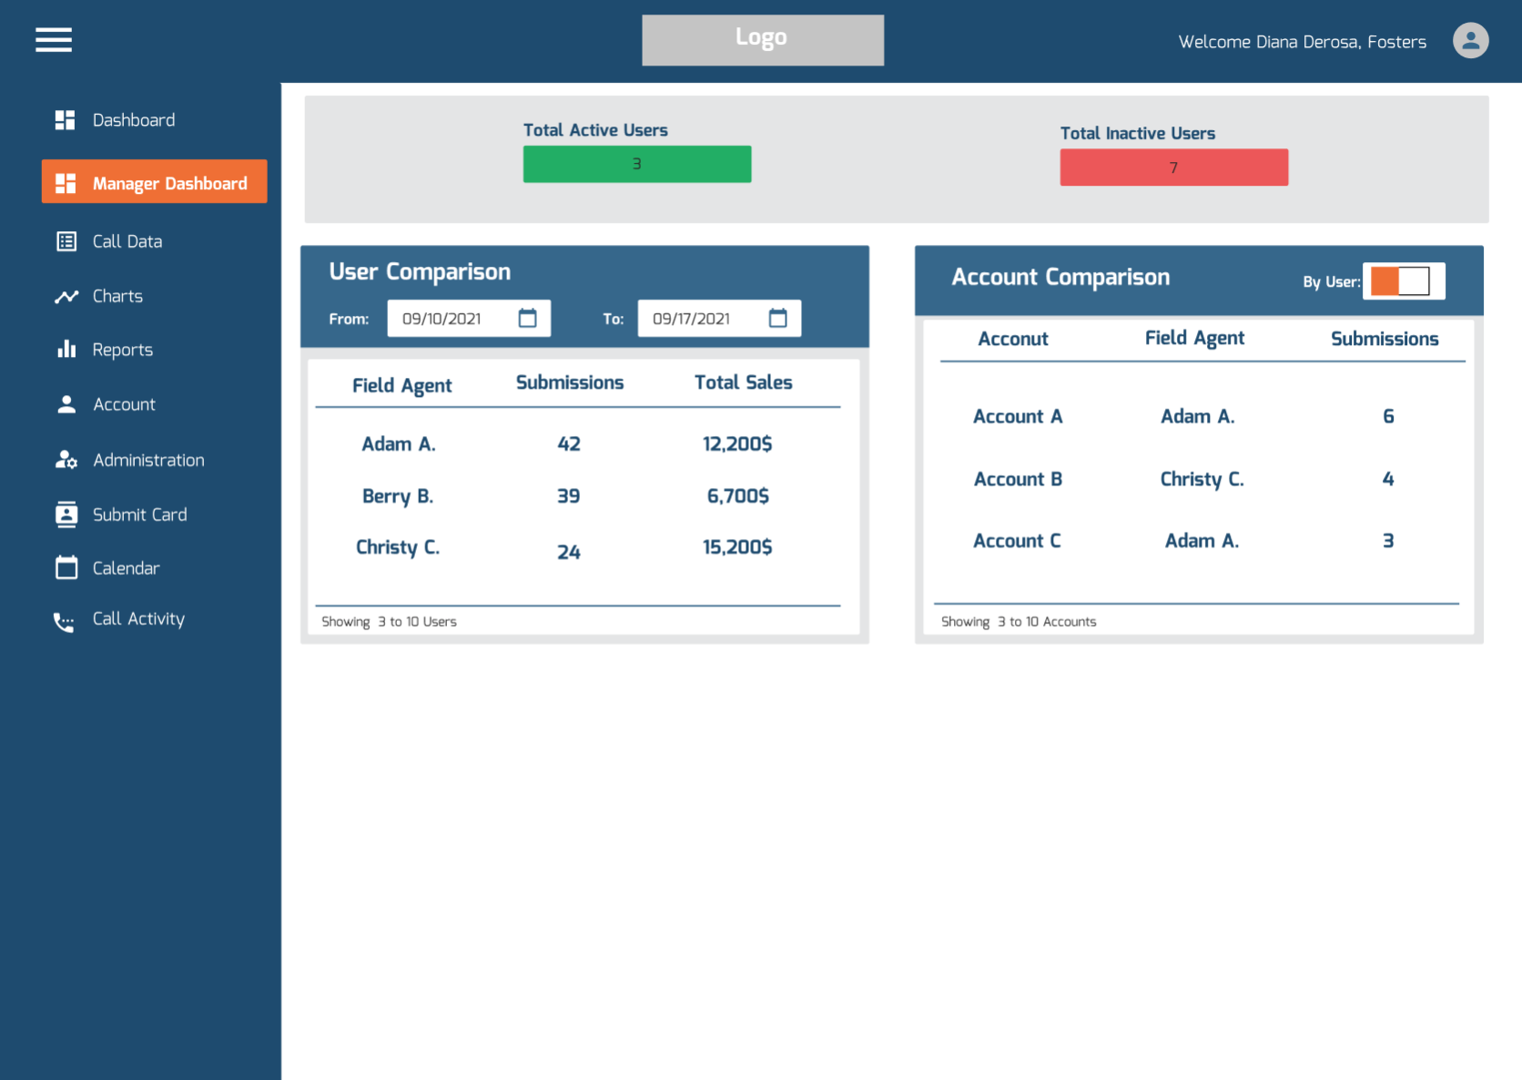
MVP

Slide 12
Solution and Additional Problems Solved
1
3
5

Slide 13
Objectives and Key Results
Increase Engagement of Manager User Type
Decrease Account Churn
Increase number of manager users in application by 8% by Q4
Manager levels users log in an average of 3 times a week by Q3
Decrease churn by 25% from previous year by end of Q4

Slide 14
Roadmap
Feb
March
April
May
June
Deployment
MVP
User Activity
Card Breakdown
Iterating Based on Feedback
Quantitative Research
Google Analytics Event Trackers
Reinforce Focus with OKR’s / Data
Quantitative Assessment
Qualitative Research
Feedback from Managers and Executives
Marketing
Email Mock Ups
Email Campaigning

Slide 15
Thank You
Questions?
Feedback? (How can I be better?)

